Slide 1




IBM Agentic-AI Final Project
Title:
Quality Education - Ensure inclusive and equitable quality education and promote lifelong learning opportunities for all.
Subtitle: Ensure inclusive and equitable quality education and promote lifelong learning opportunities for all.

Slide 2

Problem Statement
Quality Education - Ensure inclusive and equitable quality education and promote lifelong learning opportunities for all.
Subtitle: Ensure inclusive and equitable quality education and promote lifelong learning opportunities for all.
Small Gist “Students waste 37% of study time searching textbooks” – Purdue Study
Common Pain Points:
• Diagrams and equations lack proper explanations • No interactive Q&A with textbook material • Scanned books feel flat and unengaging

Slide 3

Key Features of our Solution
Tagline: Upload. Ask. Understand.
How it Works:
1. Upload PDF (text or scanned) 2. AI extracts and understands content (text + diagrams) 3. Chat interface lets you ask: “Explain Fig 3.2 on page 45”
In-short: The AI Textbook Tutor offers advanced capabilities for PDF processing, semantic search, and AI-assisted learning.

Slide 4


AI Textbook Tutor Overview
Made by [Presented by: Lunatics], AI Specialists
Group Members:
• Akshay Harits • Lalith Vishnu Ramuni • Kripalu Sonar
College: Indian Institute of Technology Hyderabad

Slide 5


Usage Instructions Overview
Uploading PDFs
Click on the upload button
Select the desired PDF file
Wait for processing to complete
Conducting Searches
Enter keywords in the search box
Review highlighted results on screen
Click for detailed explanations provided

Slide 6

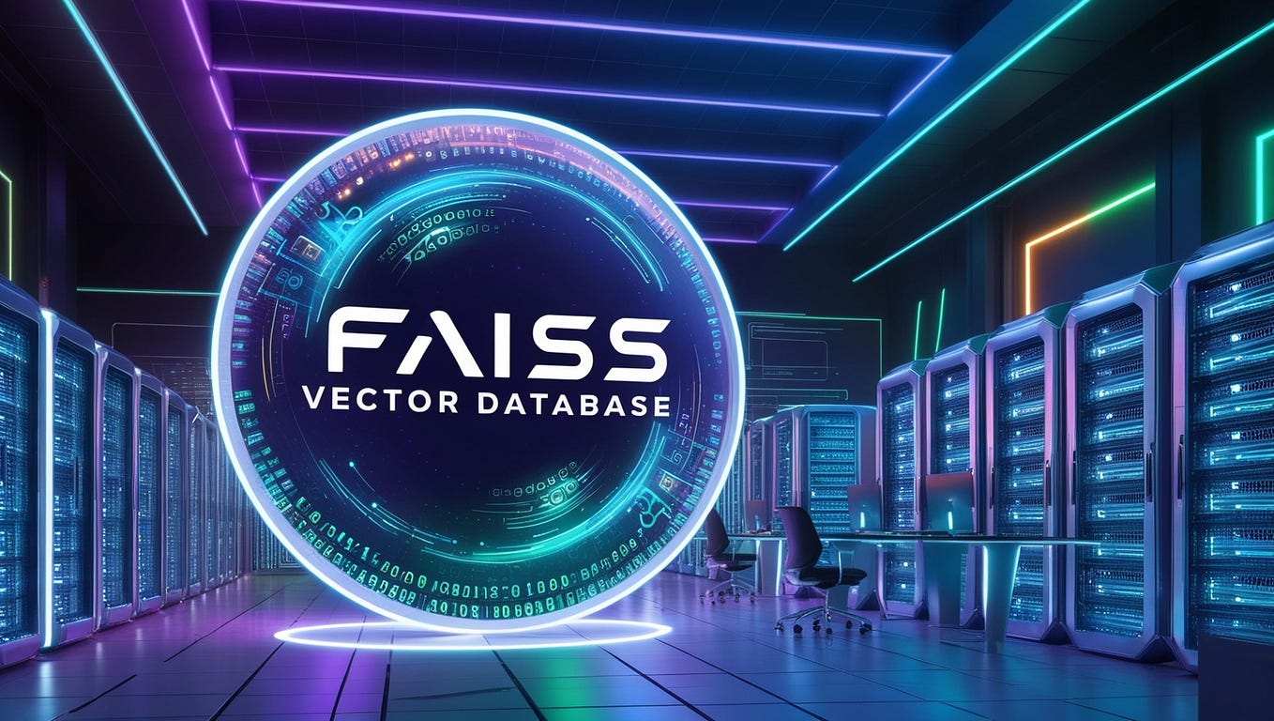


PDF Processing Capabilities
Multimodal RAG Engine:
• Gemini 1.5 with 1M token context
• FAISS + Sentence Transformers
PDF Intelligence:
• PyMuPDF + OpenCV (for diagrams)
• Tesseract OCR (with math & formula support)

Slide 7
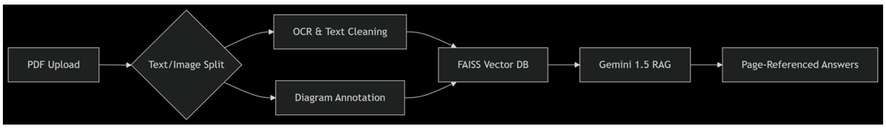
Tech Stack Overview
01
PDF Processing: Extracts and cleans text, pulls diagrams, charts, and equations from pages, and uses OCR (Tesseract) for text inside images.
Semantic Search: Uses FAISS vector search over both text and AI-generated image descriptions, with context-aware chunking for better retrieval.
.
02
02
Streamlit — Rapid Python-based framework for building interactive data apps and dashboards without frontend coding.
Google Gemini 1.5 (Vision + Text) — Advanced multimodal large language model enabling seamless understanding of both images and text.
.

Slide 8
Installation Steps Overview
01
System Requirements for AI Textbook Tutor
Ensure your system meets the minimum requirements.
02
Setup Instructions for Installation
Follow the steps to successfully install the software.
03
Common Issues During Installation
Troubleshoot problems by checking error messages.

Slide 9

AI Answering Features
Natural Language Understanding
User Interaction
The system comprehends user queries effectively.
Users receive instant feedback on their questions.
Response Accuracy
Future Enhancements
Answers provided are based on reliable data sources.
Continuous improvements will refine user experience further.

Slide 10
User Interface
Layout Overview
User Experience
The layout supports intuitive navigation and ease of use.
Enhancements focus on engagement and user satisfaction.
Accessibility
Future Improvements
Features ensure inclusivity for all users.
Planned features will include advanced AI interactions.

Slide 11
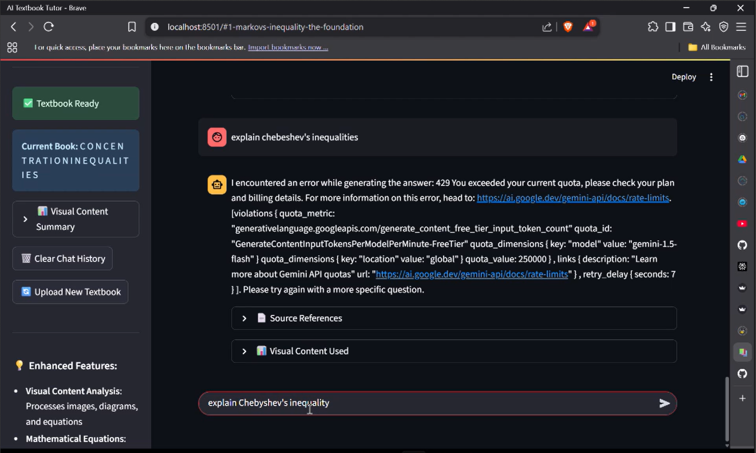

Use Case
Use Case: Biology student studying mitosis
Key Interactions:
• Walk me through the cell division stages on page 88 • Derive equation 5.1 step-by-step • Quiz me on Chapter 7 concepts

Slide 12
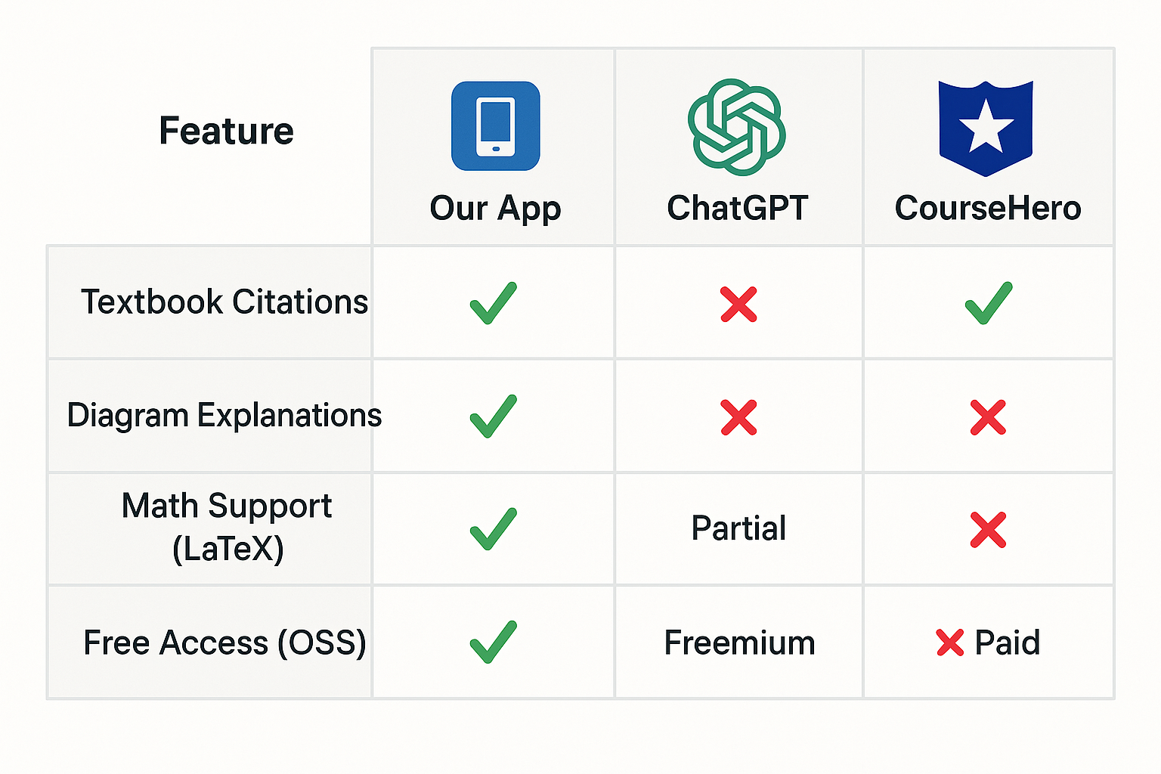
Competitive Edge
Our app stands out by offering textbook citations with page numbers, clear diagram explanations, full LaTeX math support, and open-source free access. It’s built to empower learners with transparency, clarity, and accessibility.
https://github.com/AkshayHarits/AI-Textbook-Tutor

Slide 13
Limitations of AI Textbook Tutor
01
Retrieval can be less accurate
for very large books or long,
complex questions.
02
Free-tier users may be limited by token limits (250k input tokens/minute) and rate limits.
03
Initial processing of large books can take several minutes.

Slide 14

Future Enhancements Overview
& AI Agent Features
Upcoming improvements will focus on enhanced AI capabilities, expanded PDF support, and user feedback integration.
Phase One
Phase Two
Phase Three
Progress Report Agent – Tracks sessions, sends email summaries, and highlights strengths/weaknesses.
Learning Plan Agent – Creates structured learning plans that adapt as you progress.
Assessment & Evaluation Quiz & Test Agent – Generates quizzes and provides instant scoring with explanations.

Slide 15

Thank You!
Email
Git Hub
Linkedin
Lalith : ic23btech11016@iith.ac.in Akshay : ritsukyasha@gmail.com
Kripalu : kripalusonar2906@gmail.com
Project : https://github.com/AkshayHarits/AI-Textbook-Tutor Lalith : https://github.com/rlv-iith Akshay : ritsukyasha@gmail.com
Kripalu : https://github.com/KripaluSonar06
Lalith Akshay
Kripalu

